Slide 1
Docker Course
DeVops

Slide 2
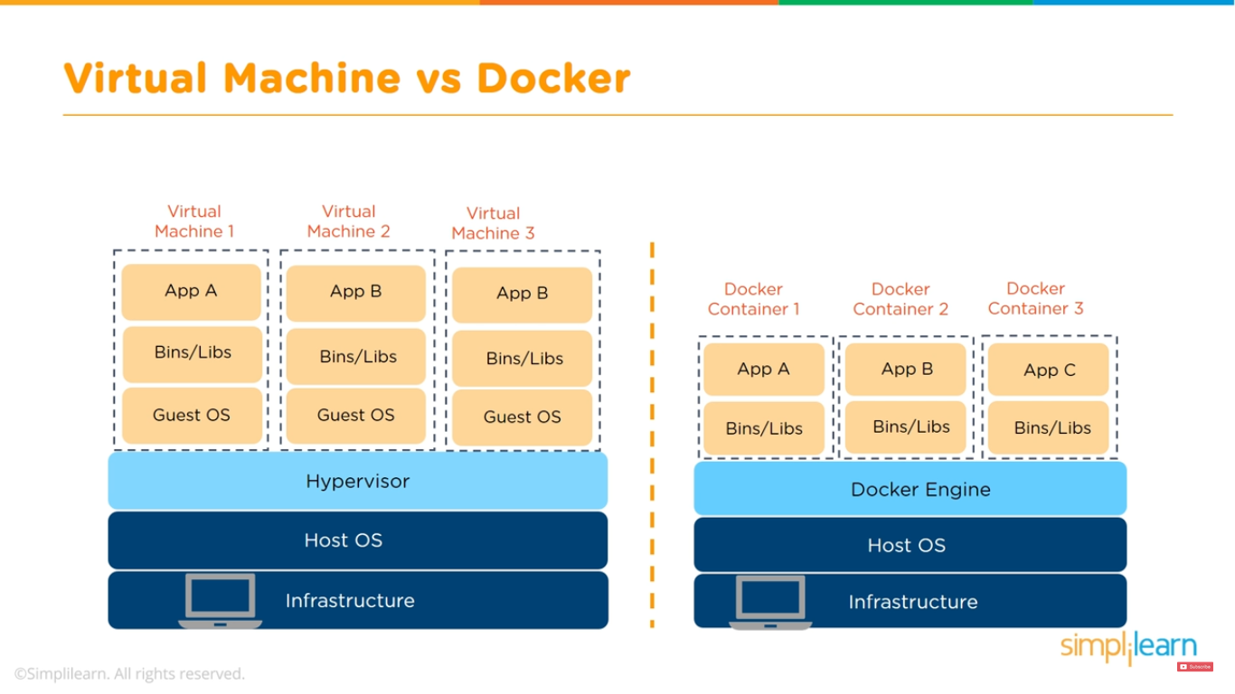
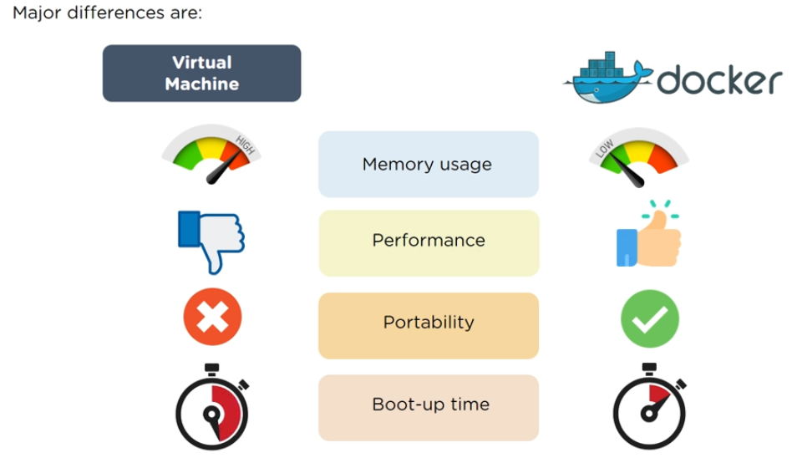
Docker container vs Virtual Machine

Slide 3
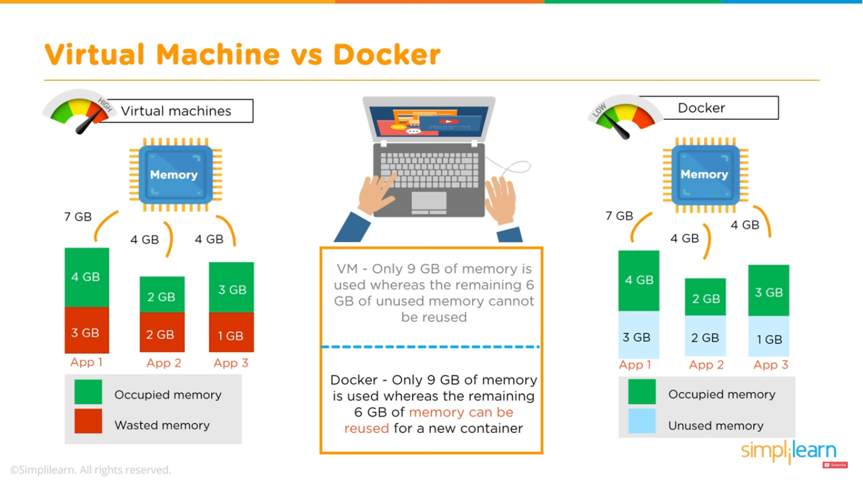

Slide 4
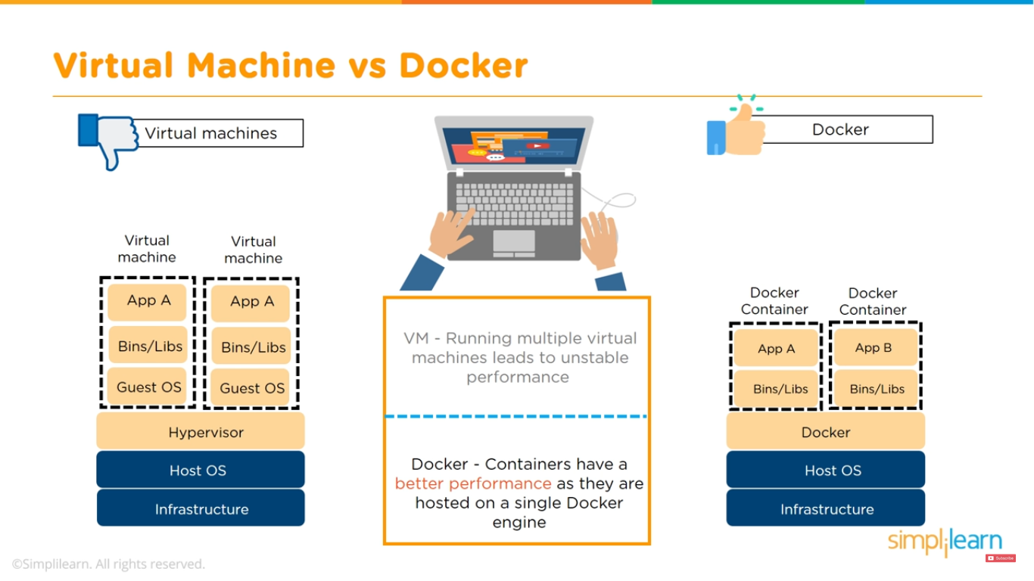

Slide 5
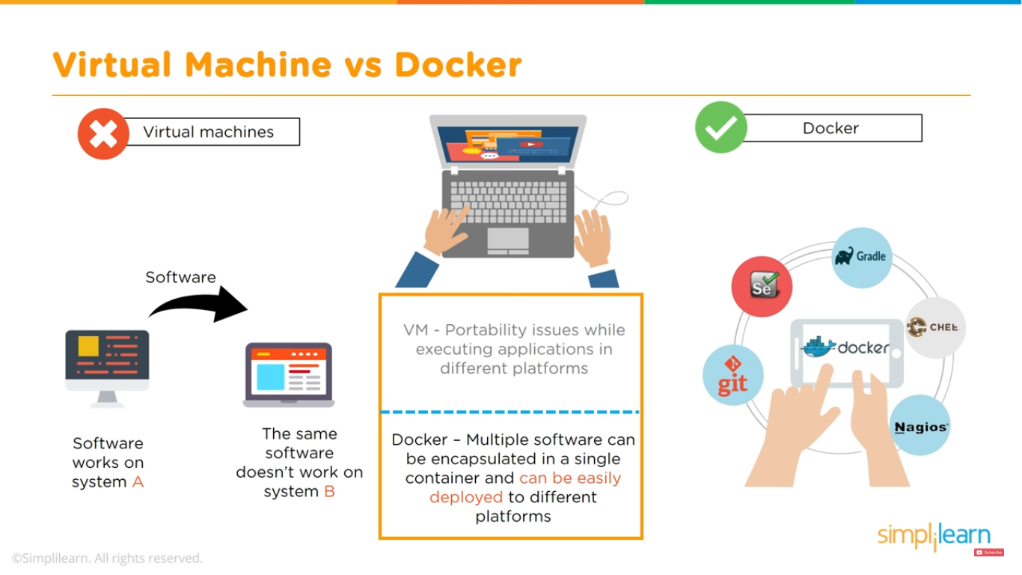

Slide 6
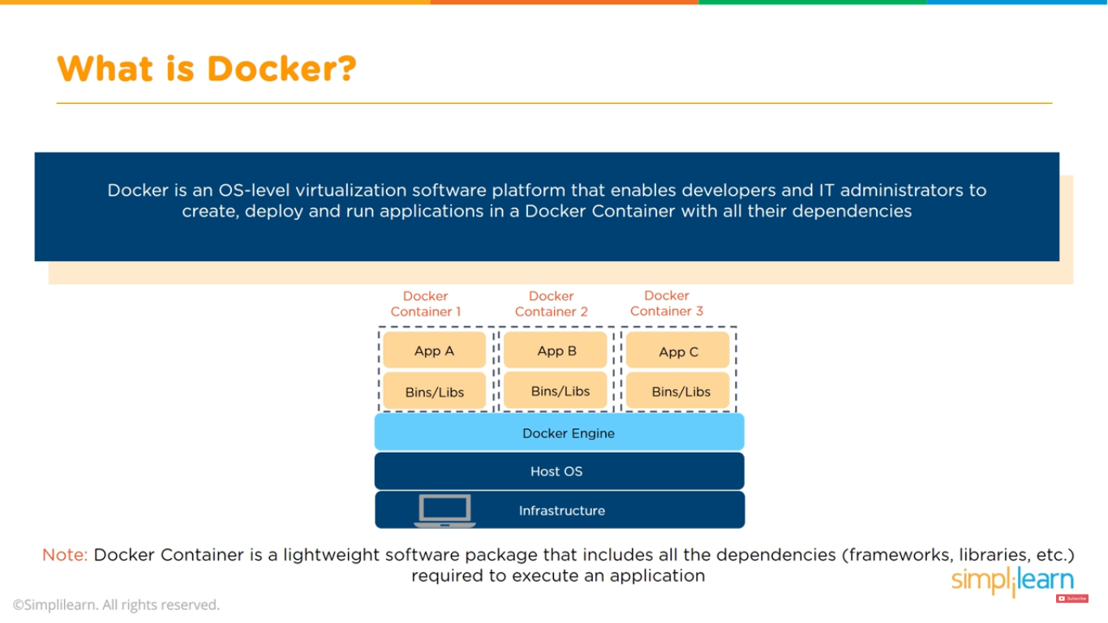

Slide 7
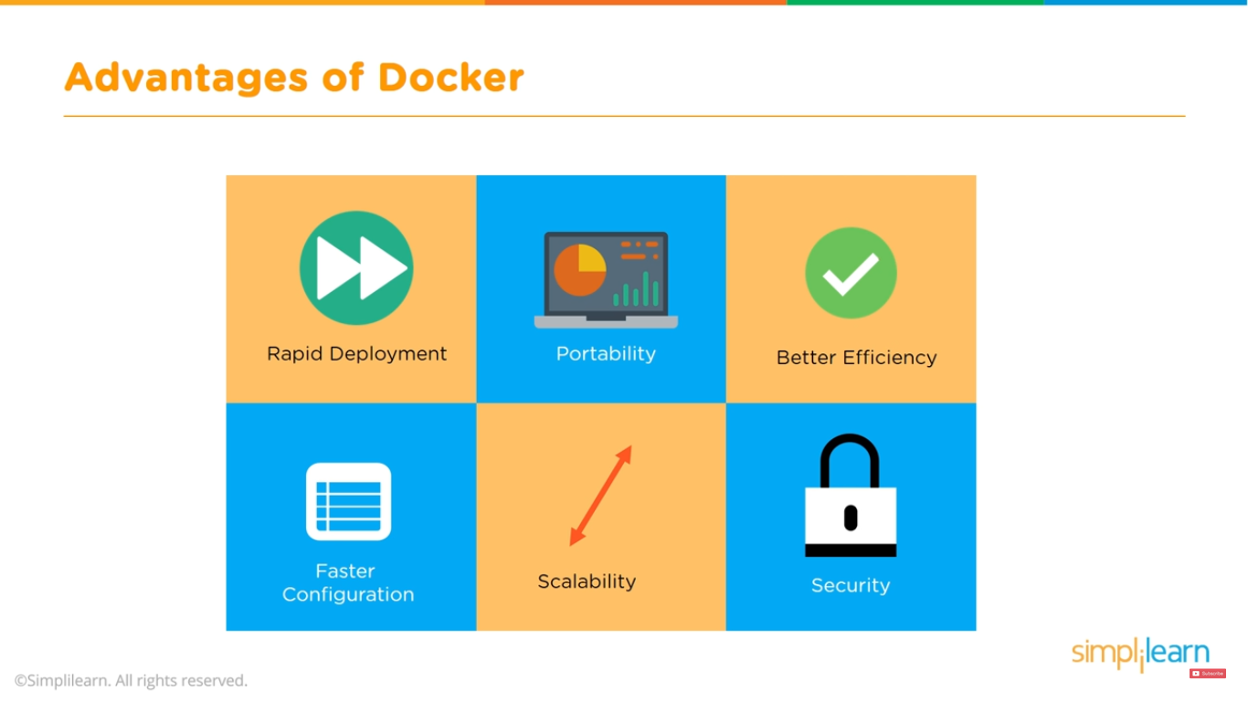

Slide 8
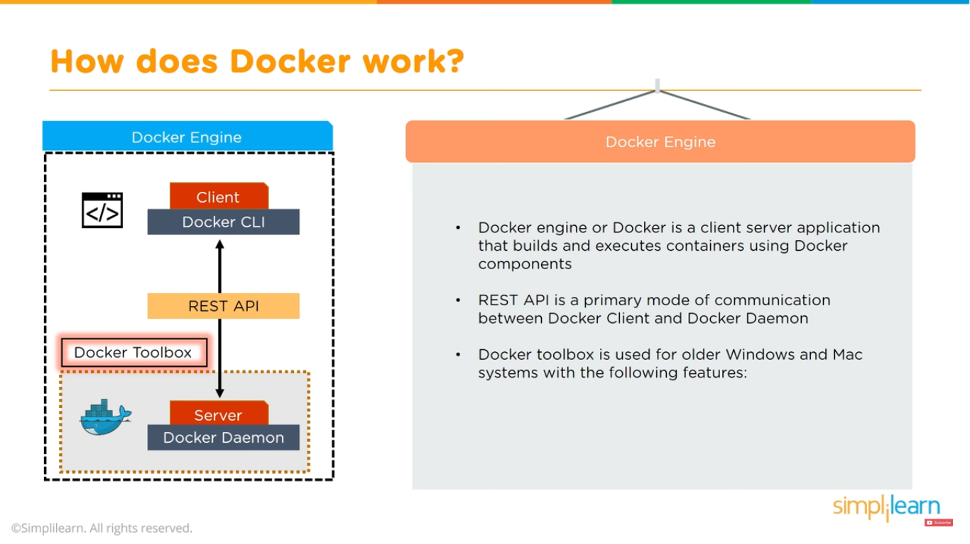

Slide 9
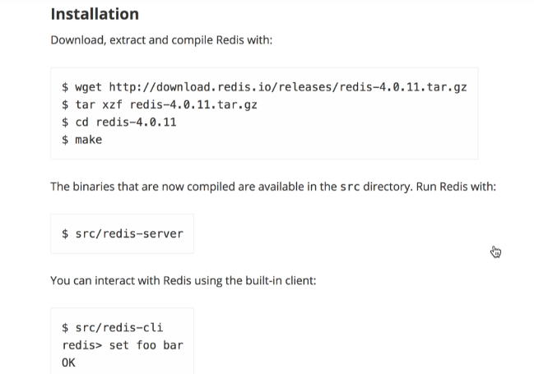
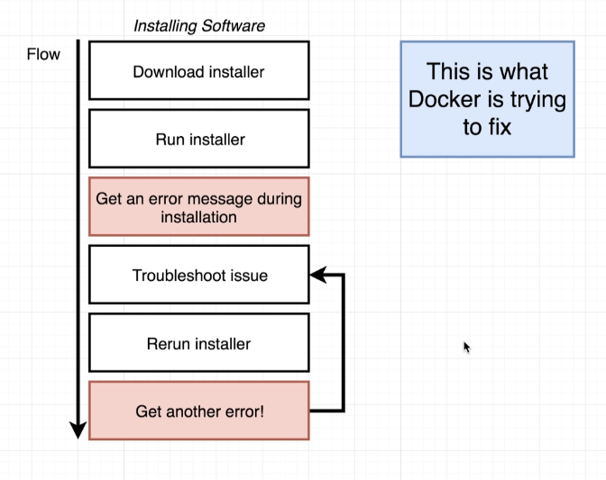
Why Docker

Slide 10
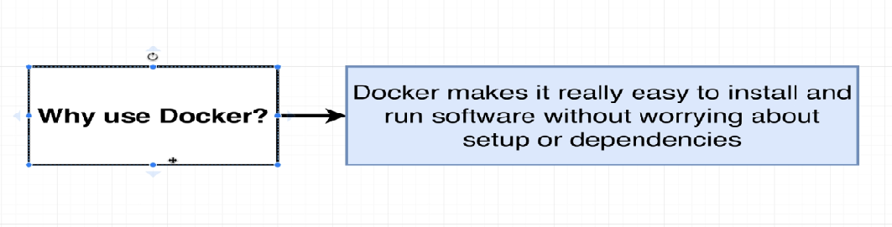
#docker run –it redis

Slide 11
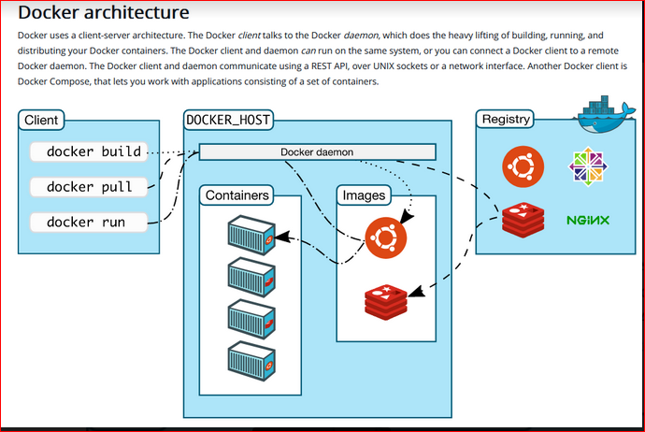
Docker Arch

Slide 12
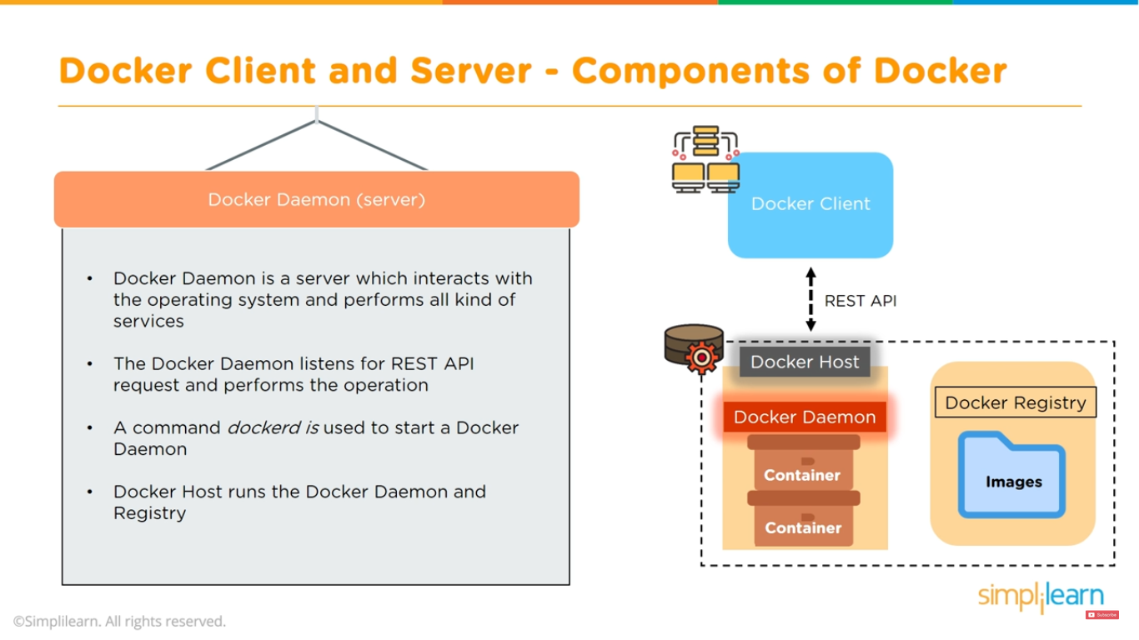

Slide 13
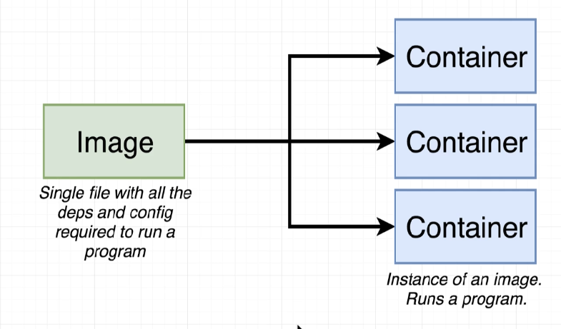
What is container ? When Running last command docker CLI reaches Docker Hub and Downloaded image called redis ( in memory datastore)

Slide 14
Docker image and container
A Docker image is a read-only template that contains a set of instructions for creating a container that can run on the Docker platform. It provides a convenient way to package up applications and preconfigured server environments, which you can use for your own private use or share publicly with other Docker users
Containers
A container is a runnable instance of an image. You can create, start, stop, move, or delete a container using the Docker API or CLI. You can connect a container to one or more networks, attach storage to it, or even create a new image based on its current state.
By default, a container is relatively well isolated from other containers and its host machine. You can control how isolated a container’s network, storage, or other underlying subsystems are from other containers or from the host machine.

Slide 15
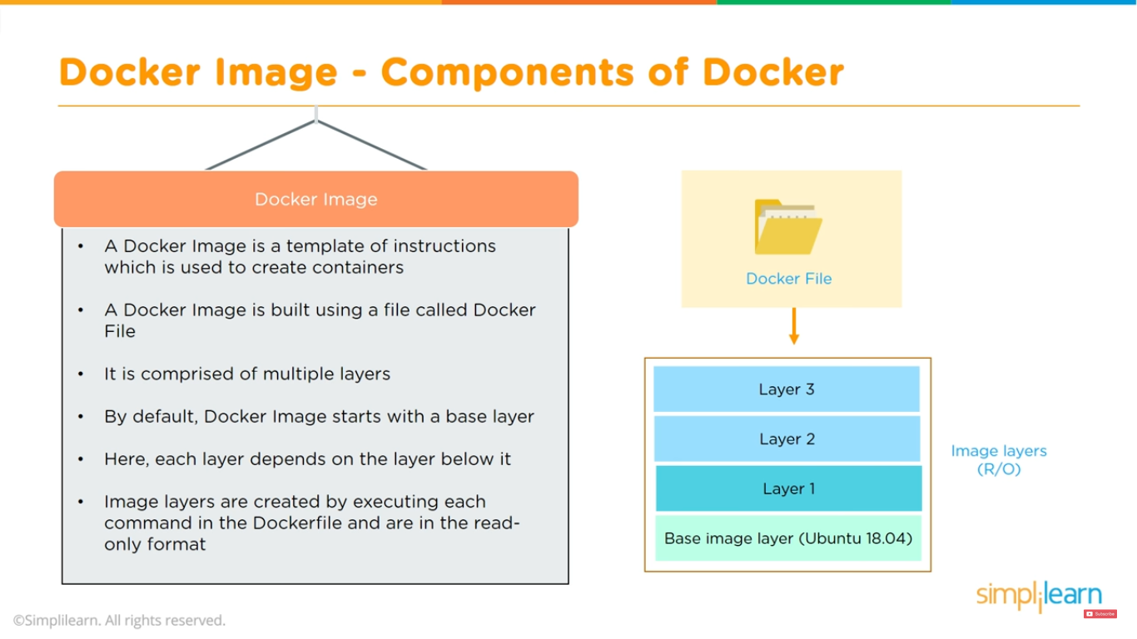

Slide 16
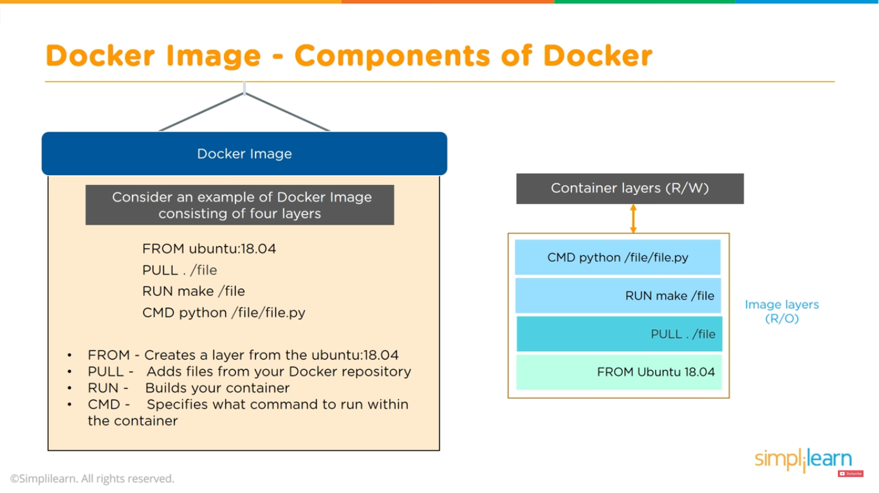

Slide 17
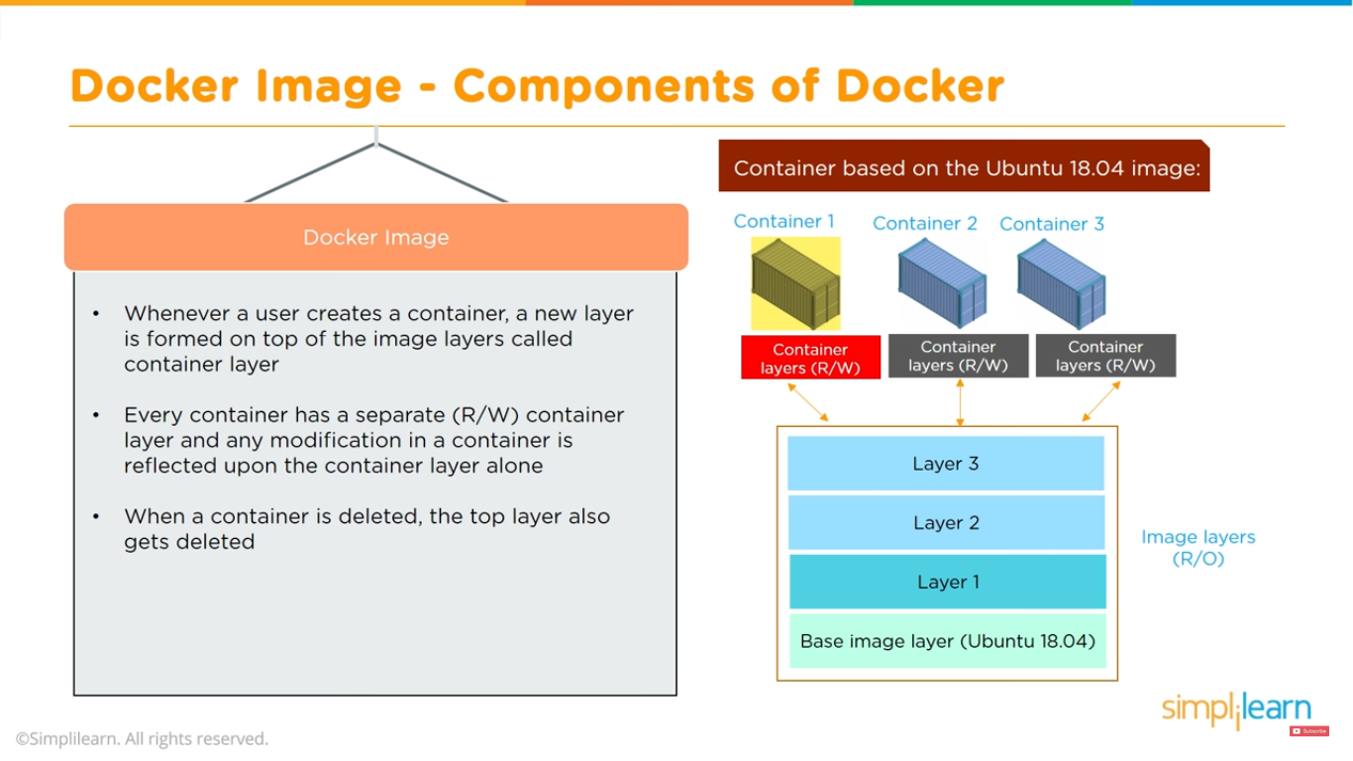

Slide 18
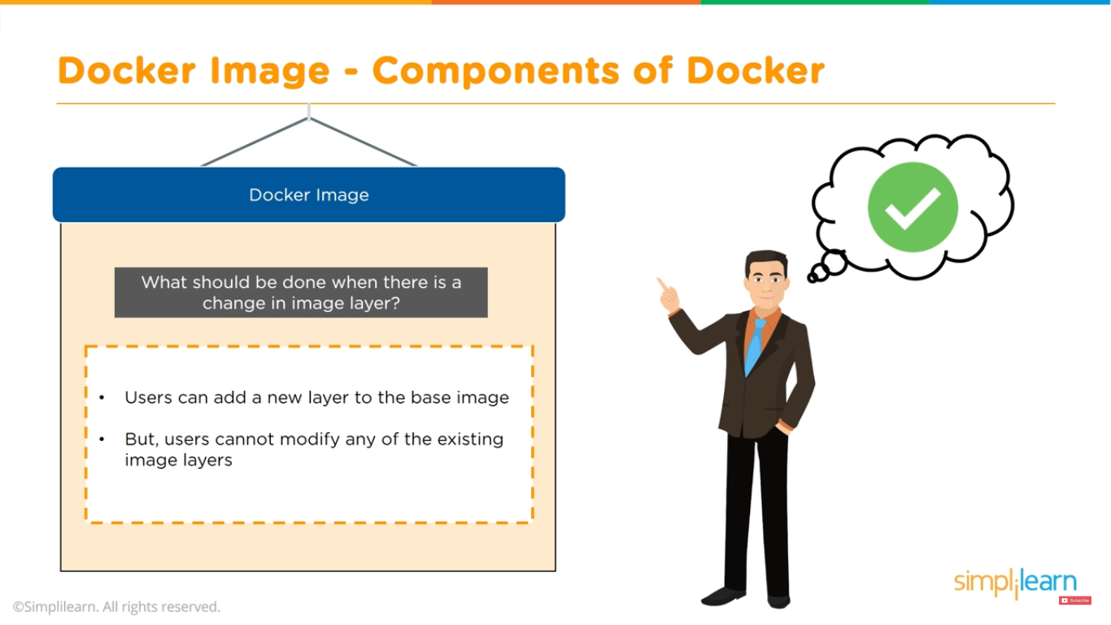

Slide 19
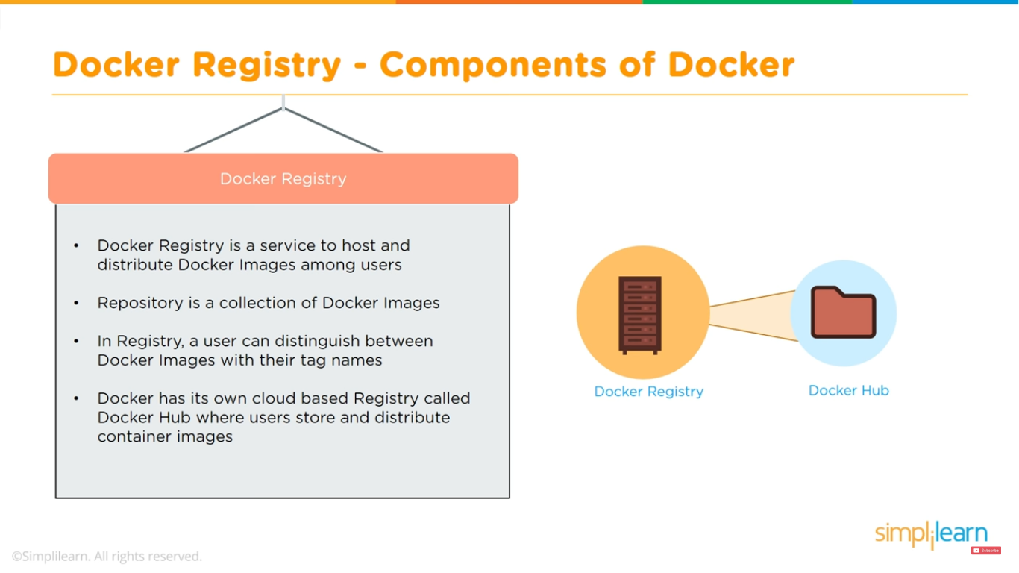
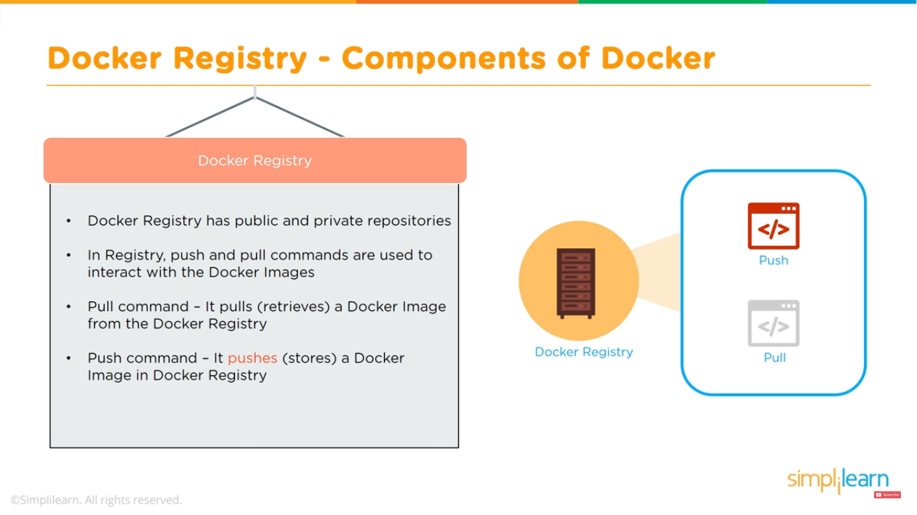
Docker Registry deleting repository is not reversible ( it will gone) Docker Hub is a registry service on the cloud that allows you to download Docker images that are built by other communities. You can also upload your own Docker built images to Docker hub. In this chapter, we will see how to download and the use the Jenkins Docker image from Docker hub.

Slide 20
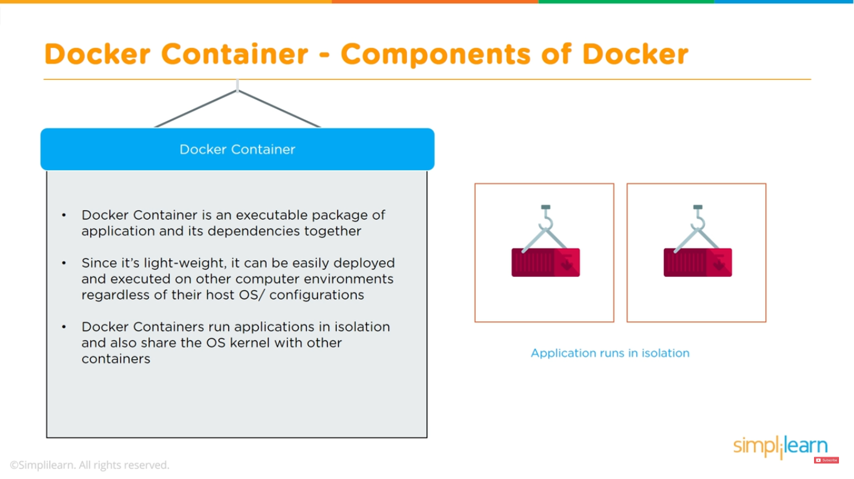

Slide 21
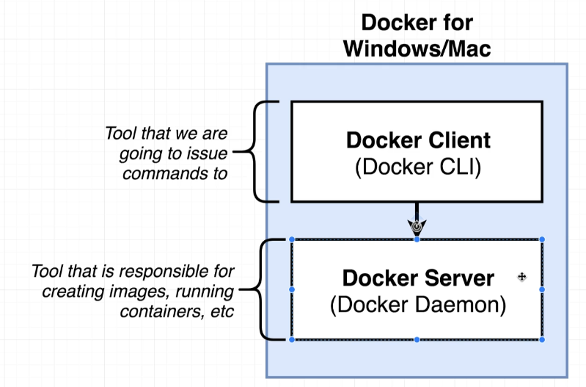
Docker : Mac / Windows docker client: tool to help us interact with Docker Daemon
WSL2
Windows 10 Pro and some Windows 10 Home users will be able to install Docker Desktop if their computer supports the Windows Subsystem for Linux (WSL2).
Please see this guide first which includes all of the steps to install and enable WSL2:
https://docs.microsoft.com/en-us/windows/wsl/install-win10
Once you have successfully installed and enabled WSL2 and then installed the Linux OS of your choice, continue to the Docker Desktop installation docs here:
https://docs.docker.com/docker-for-windows/wsl/

Slide 22
Installing Docker in Linux
Installing Docker on Linux
These steps listed below are for Ubuntu Desktop LTS. You can find the full official docs and steps for other
Linux distributions here:
Ubuntu: https://docs.docker.com/install/linux/docker-ce/ubuntu/
CentOS: https://docs.docker.com/install/linux/docker-ce/centos/ (Note: Students have encountered issues when using CentOS or RHEL as the host related to Docker container
communication. You may need to research some workaround for the errors you run into or search the QA for
already posted solutions)
Debian: https://docs.docker.com/install/linux/docker-ce/debian/

Slide 23
Installing Docker on Linux
Installation Steps
Create Dockerhub account https://hub.docker.com/signup
Install Docker The Docker docs suggest setting up a Docker repository to install and update from. This is where you should start: https://docs.docker.com/install/linux/docker-ce/ubuntu/#set-up-the-repository
3- Login to the Dockerhub In order to push and pull images, you will need to login to the Dockerhub. In your terminal, run :
$ docker login and then enter your Dockerhub account's username and password.
4- Test Docker installation After completing the installation steps, test out Docker by running sudo docker run hello-world. This should download and run
the test container printing "hello world" to your console

Slide 24
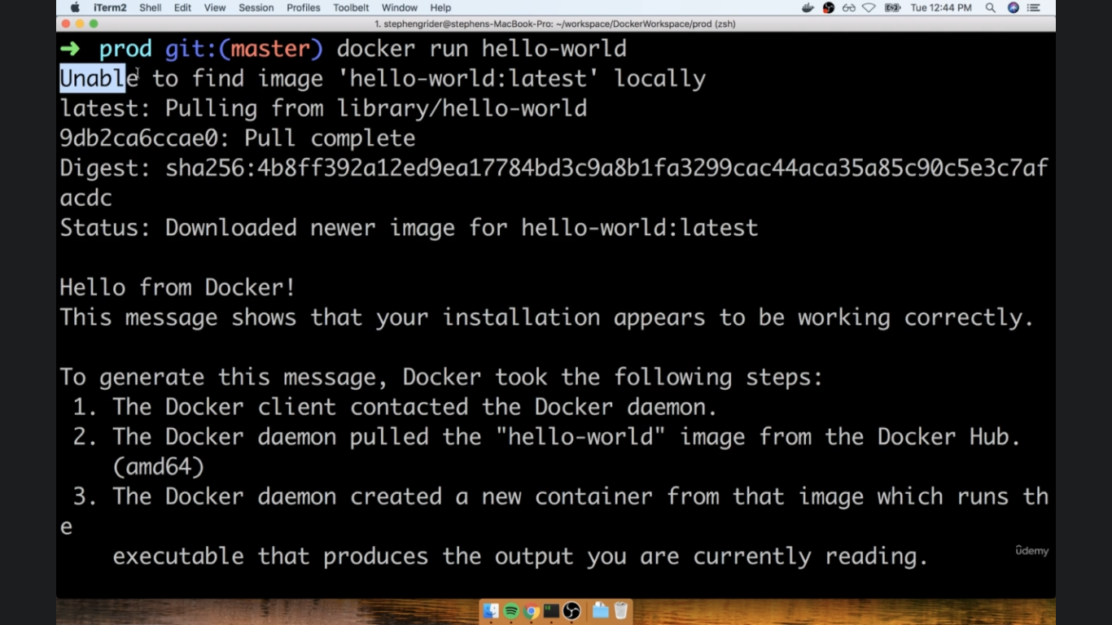
$docker –version / docker run hello-world

Slide 25
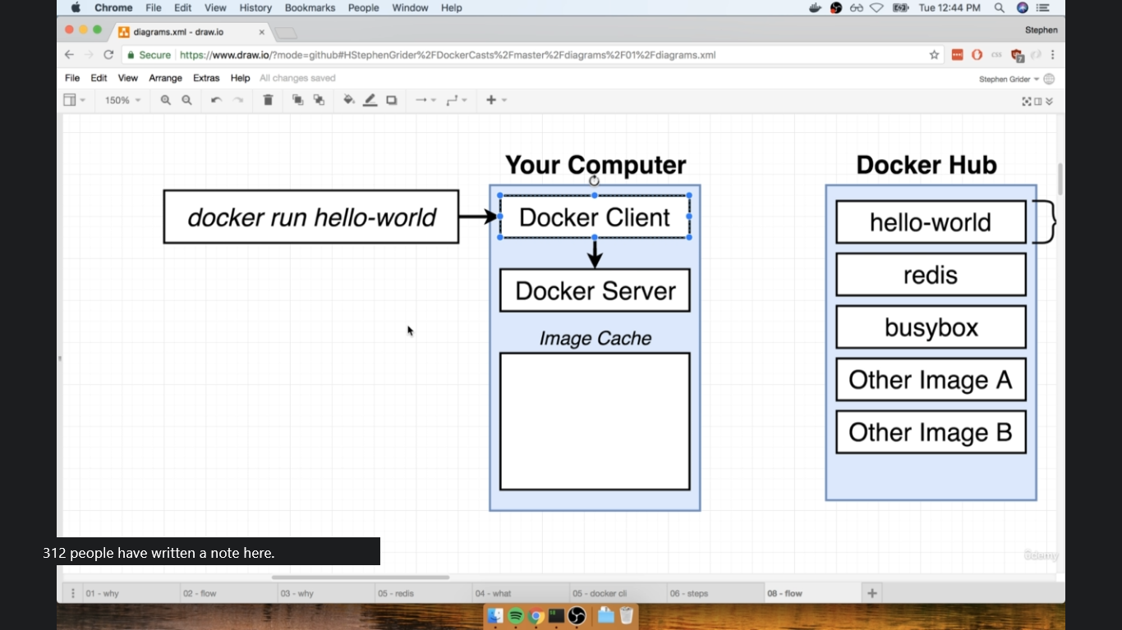
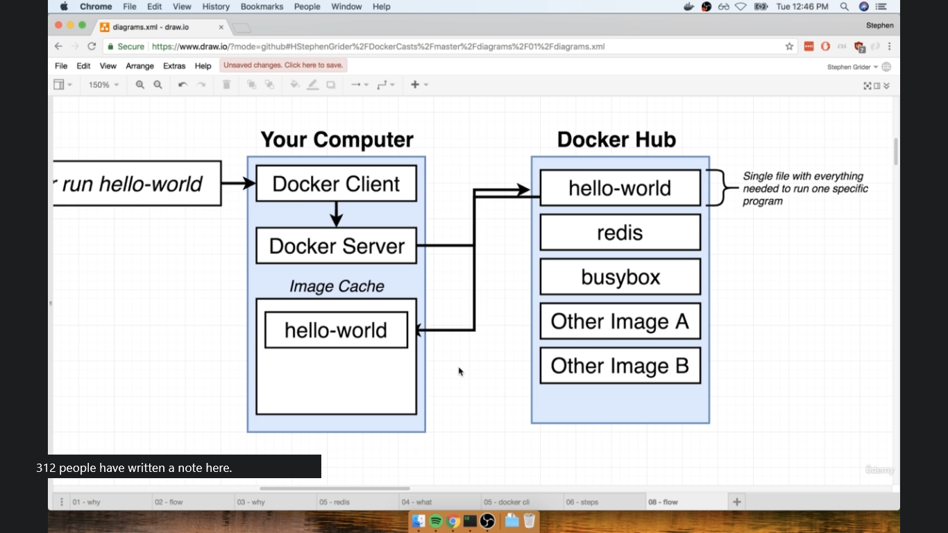
Docker run flow

Slide 26
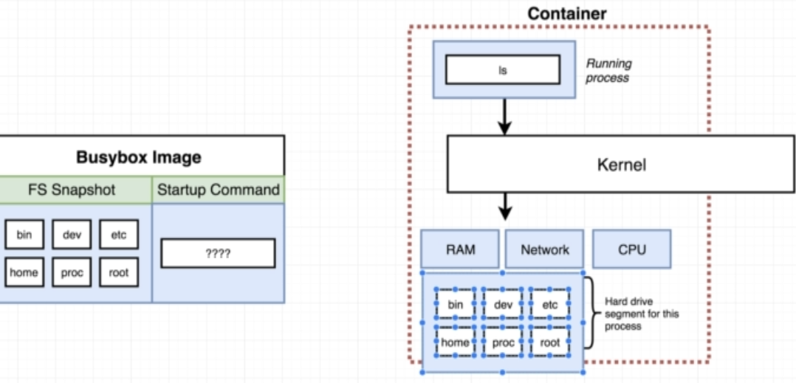
Image filesystem(default programs)

Slide 27
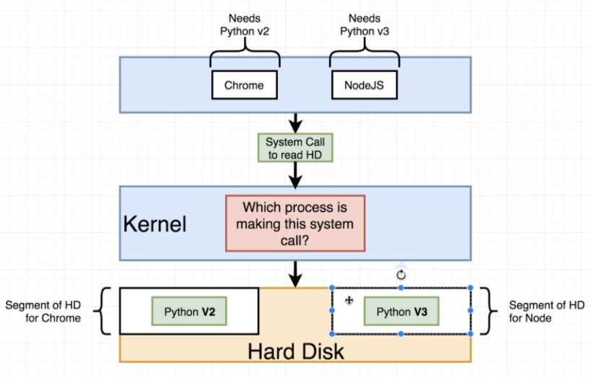
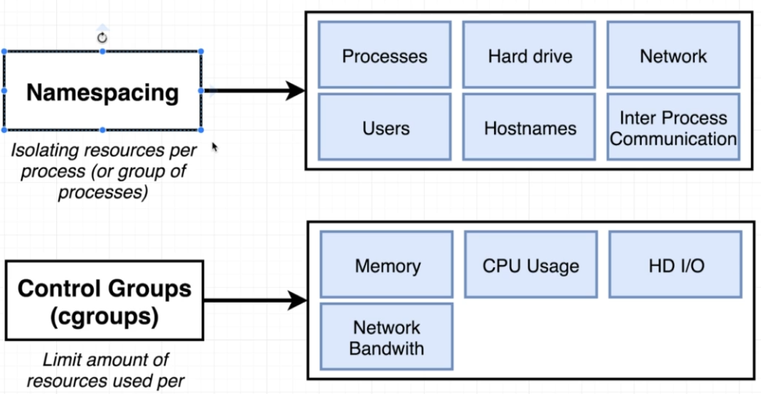
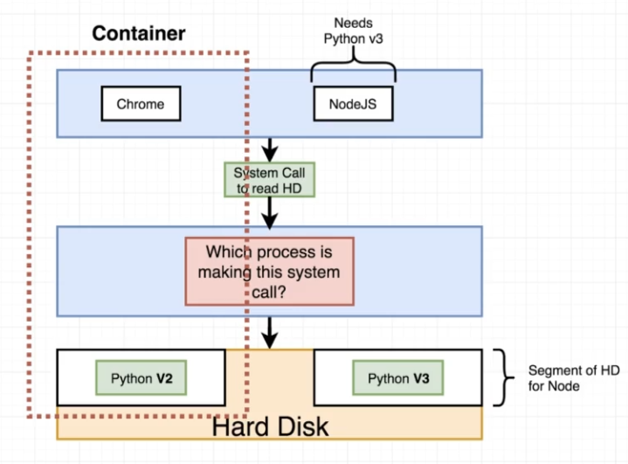
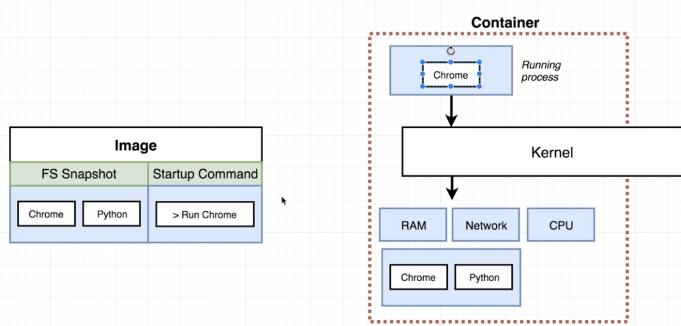

Slide 28
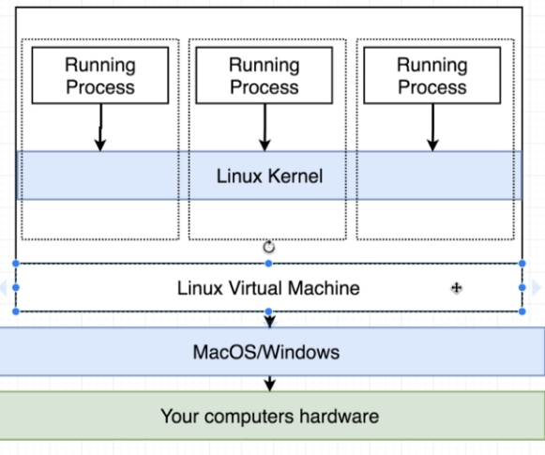
$ docker version Client: Version: 20.10.5+dfsg1 API version: 1.41 Go version: go1.15.9 Git commit: 55c4c88 Built: Wed Aug 4 19:55:57 2021 OS/Arch: linux/amd64 Context: default Experimental: true

Slide 29
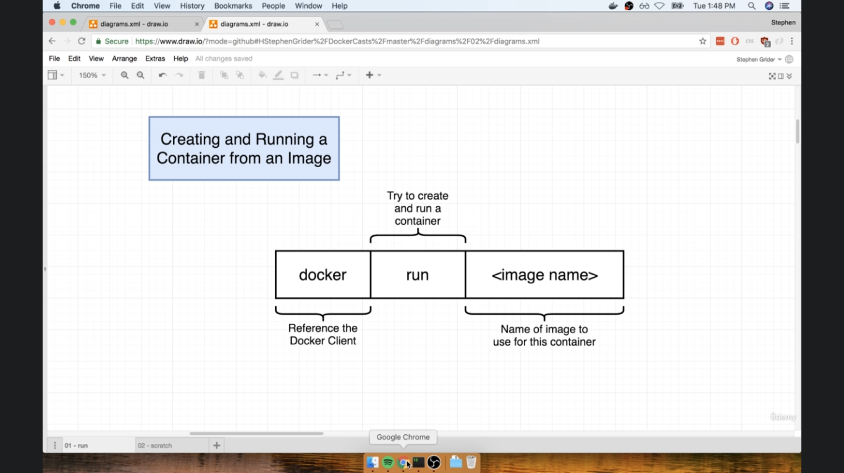
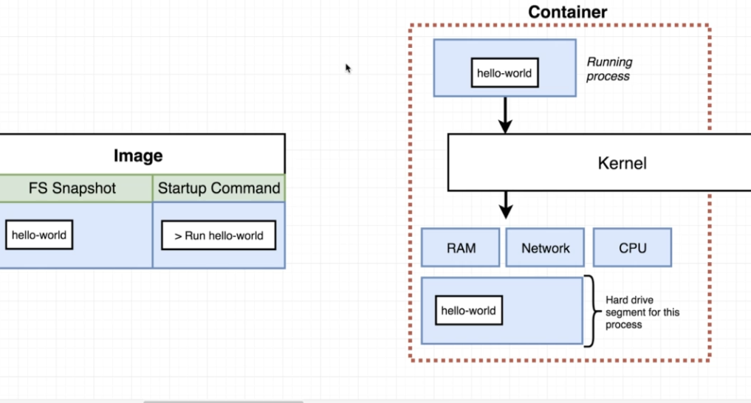
Run First Program $docker run hello-world when executing: we took snapshot and stick that program into container and run startup command hello-world

Slide 30
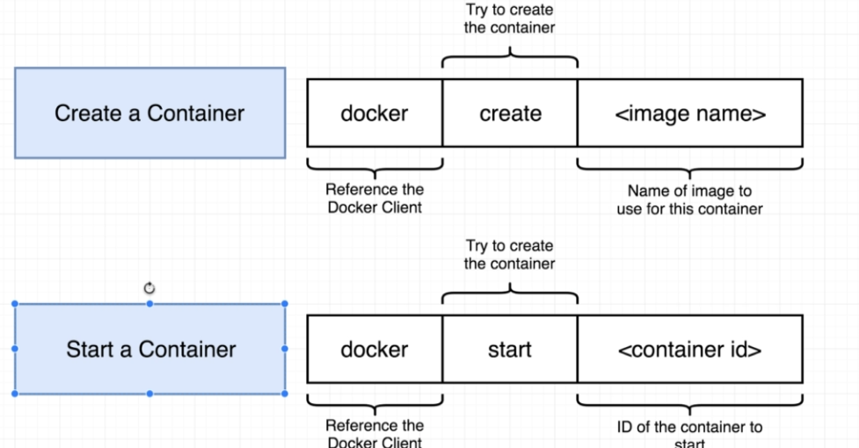
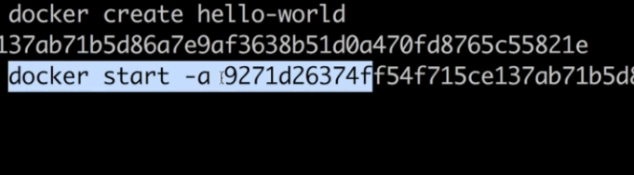
Container lifecycle Docker run : create image file system snapshot and start the startup command : docker start –a ( give output to terminal)

Slide 31
List running containers $docker ps $docker ps –a $docker run busybox ping google.com

Slide 32
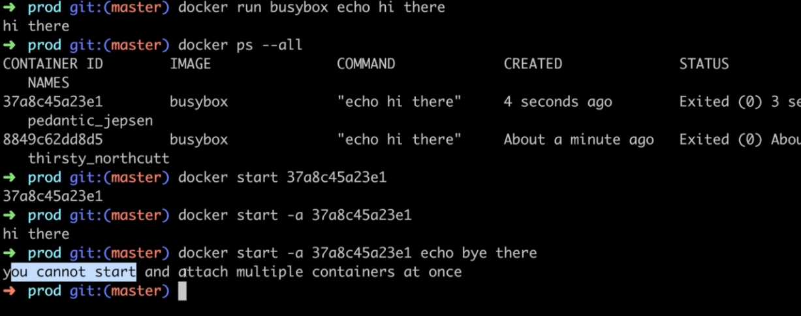
Once container created we cant change the default startup command

Slide 33
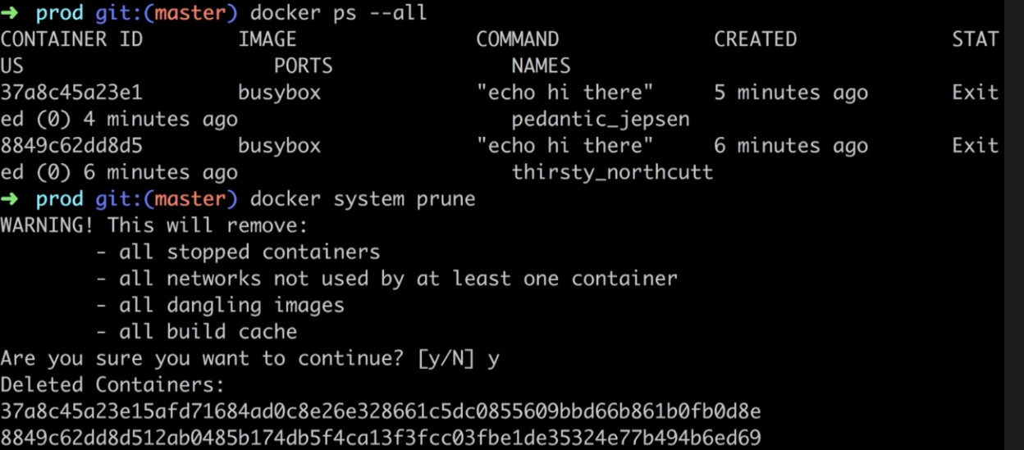
Deleting stopped containers i.e to save space : $docker system prune

Slide 34
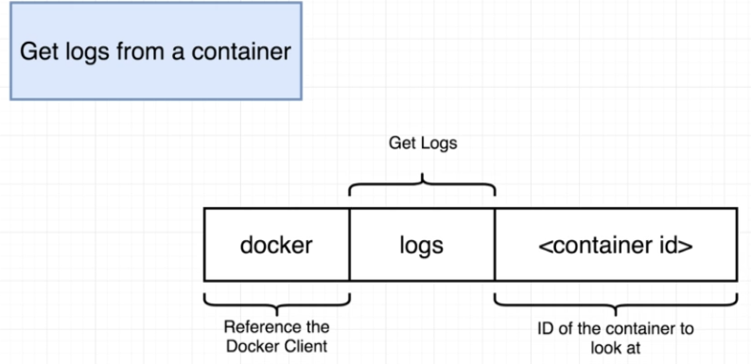
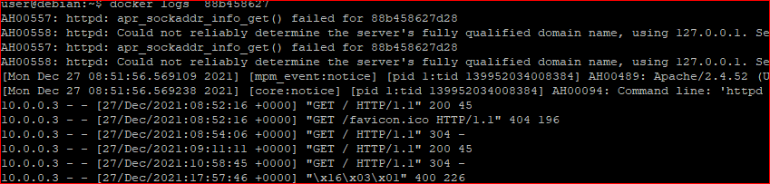
Docker retrieve Logs

Slide 35
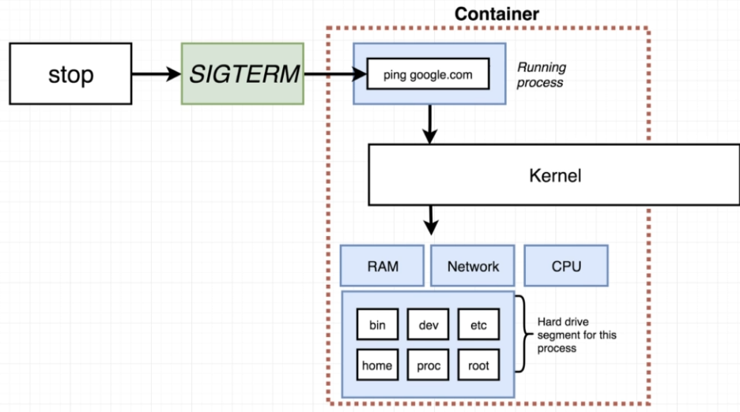
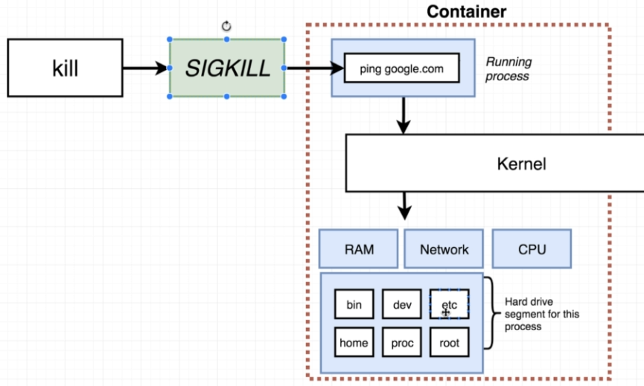
Stopping containers: Sigterm/SigKill

Slide 36
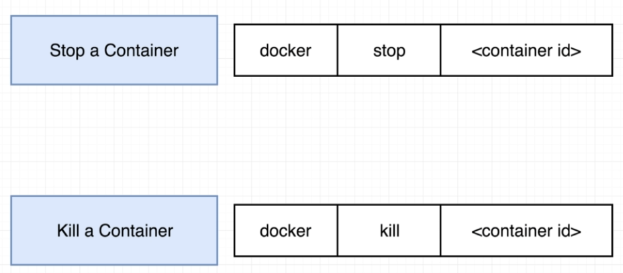
Docker stop: wait for processes to finish smoothly( has 10 seconds before kill), while kill ask to finish immediately

Slide 37
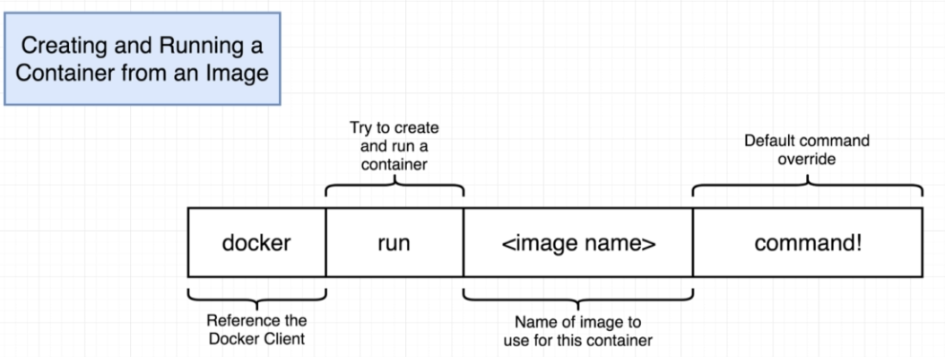
Override the startup command $docker run busybox echo hi man $docker run hello-world ls ( will not work)

Slide 38
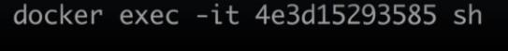
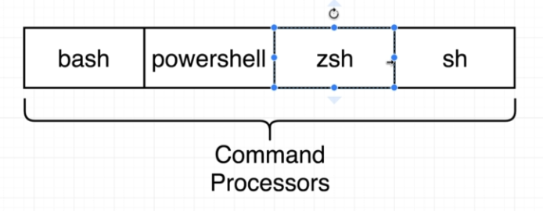
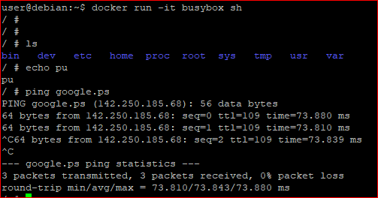
Docker run redis Redis : in-memory datastore for web app you can us it with run command also to get into running container with shell access:

Slide 39
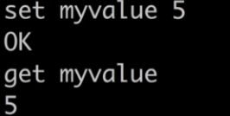
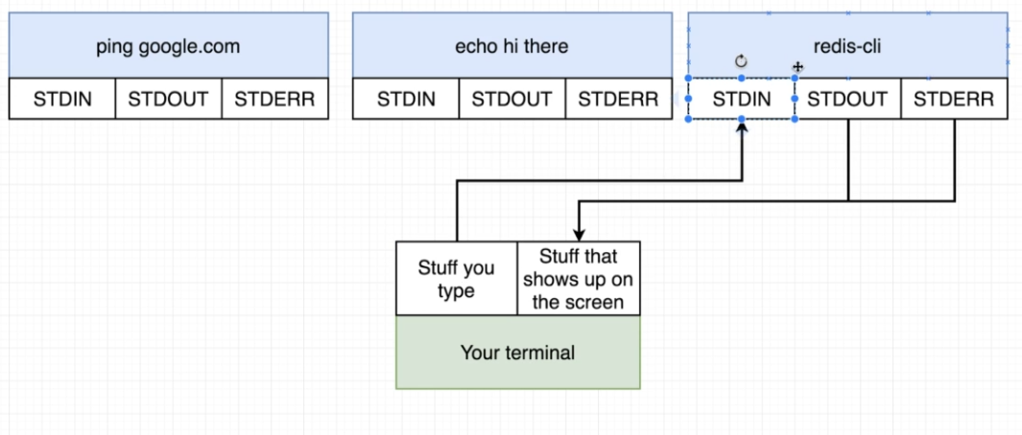
Executing commands inside running container
i: standard in / t: nice format standard out

Slide 40
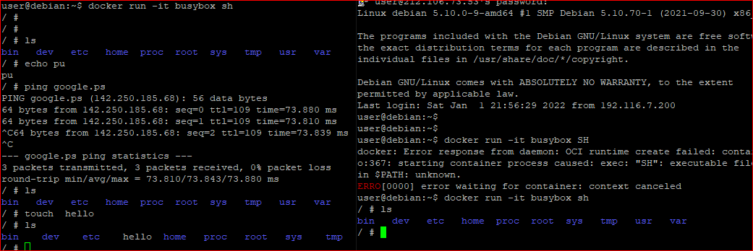
Demo : docker Isolation

Slide 41
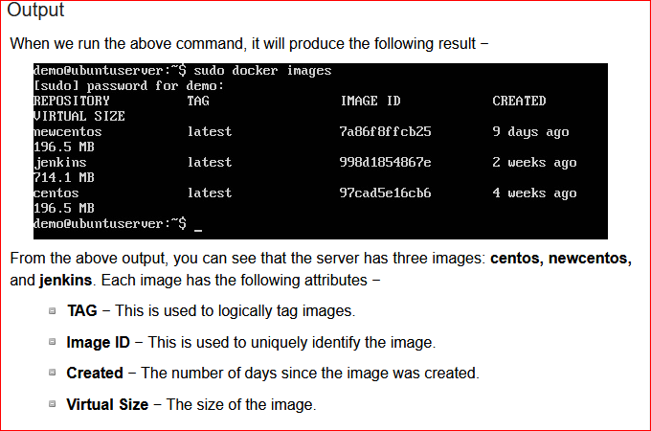
Docker images syntax: $docker images

Slide 42





Downloading/Deleting images Images can be downloaded from Docker Hub using the Docker run command. Let’s see in detail how we can do this. Syntax: docker run image

Slide 43


Docker inspect /Docker histroy

Slide 44

Docker top
docker top
With this command, you can see the top processes within a container.
Syntax
docker top ContainerID
Options
ContainerID − This is the Container ID for which you want to see the top processes.
Return Value
The output will show the top-level processes within a container.
Example
sudo docker top 9f215ed0b0d3
The above command will show the top-level processes within a container.

Slide 45



Dokcer rm /stats

Slide 46


Slide 47


Docker Compose

Slide 48


Docker swarm Manager Node send instructions to worker Nodes

Slide 49


Slide 50


Slide 51


Slide 52


Slide 53







Slide 54
Docker Networking Docker networking enables a user to link a Docker container to as many networks as he/she requires. Docker Networks are used to provide complete isolation for Docker containers.
Advantages of Docker Networking
Some of the major benefits of using Docker Networking are:
They share a single operating system and maintain containers in an isolated environment.
It requires fewer OS instances to run the workload.
It helps in the fast delivery of software.
It helps in application portability.

Slide 55


Network Drivers Docker supports networking for its containers via network drivers. These drivers have several network drivers.
Bridge
Host
None
Overlay
Macvlan

Slide 56


Bridge- Most used Network Its virtual interface that connect all internal docker containers to the docker host network Also us docker0 interface
user@app-1:~$ docker run -it -d --name nginx -p 80:80 nginx
6ef62f6354694481a8cc7f7ec1c1c85aae0ce9a4b93641754682f295ff0b8e31
Cant do name resolution.
Each time when redeploy new ip
Use custom bridge network for DNS res.
Cant isolate containers

Slide 57

Host Network When you need to run containers that should connect to other services /resources on the host and use same routing table (i. e Wirguard VPN container ). Container behave like any app running on the host and remove the isolation

Slide 58






